Slide 1

Research for Policy
”Rightful Place of Science”
2 February 2023
ASU’s Barrett & O’Connor Center
Washington, DC
Robert Cook-Deegan

Slide 2


“No one reads our papers”
There’s a good reason for that
  Bandwidth
  InfoLoad
  Schedule
”Where facts are negotiable”

Slide 3

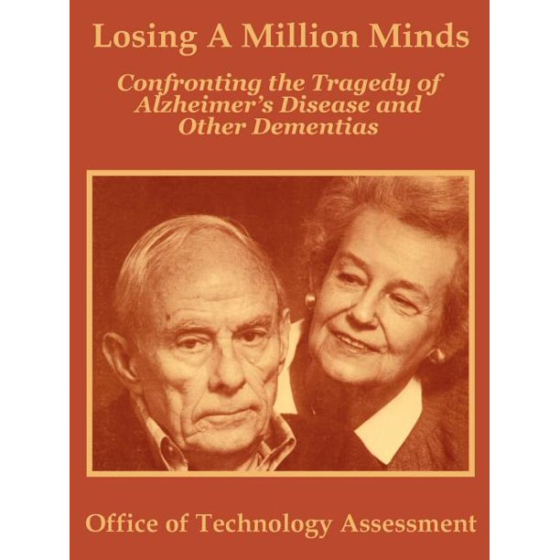
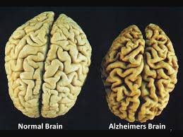
Lessons from OTA Alzheimer’s Study
Appropriations
Medicare demonstration (Waxman-Hatch-Kennedy)
Services Research (Grassley-Metzenbaum-Snowe)
Nursing home alternatives (Robert Wood Johnson Foundation)

Slide 4

Executive Order
“Medicare should reimburse routine care for patients in clinical trials in the same way it reimburses routine care for patients not in clinical trials.”
Create registry of clinical trials
Clinton Executive Order 7 June 2000

Slide 5
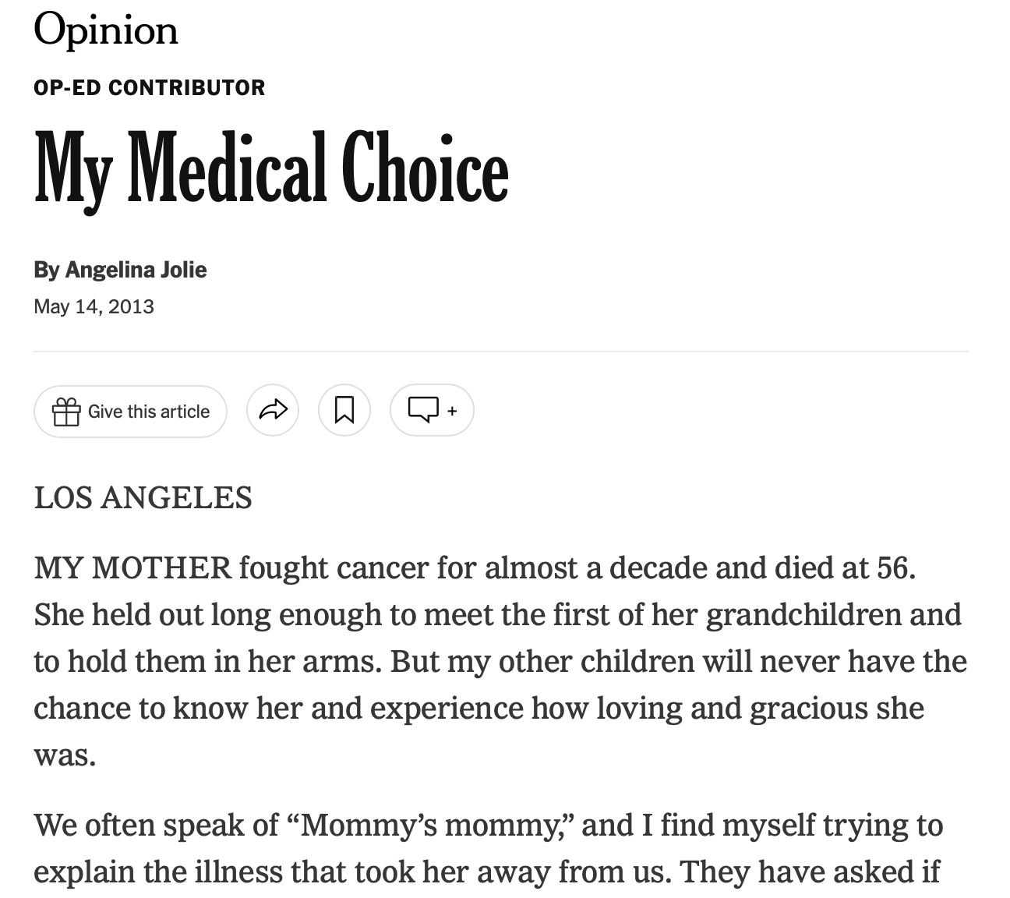
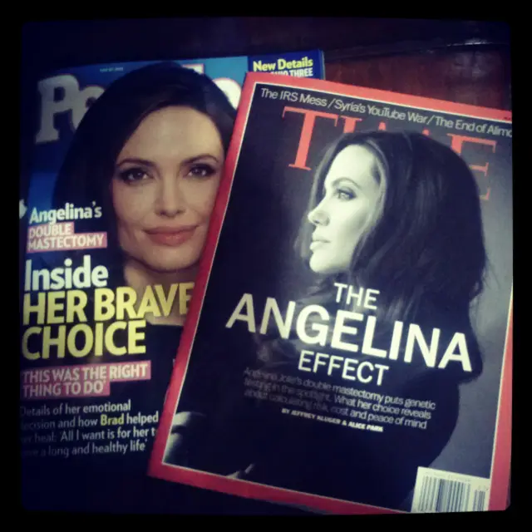
On our plate now
Genetic testing for inherited risk of cancer

Slide 6
Source: National Human Genome Research Institute, Dec 2020
https://www.genome.gov/about-genomics/fact-sheets/Sequencing-Human-Genome-cost

Slide 7

BRCA variants
Reference BRCA1 gene
“Icelandic”
40% of rare variants “new”
among breast and ovarian
cancer sequences in China, 2016
1994 BRCA1 at Utah/Myriad
1995 BRCA2 UK & Utah/Myriad
Aboriginal and Indigenous
communities
under-represented
Africa has immense
genomic diversity, variants yet to be found

Slide 8
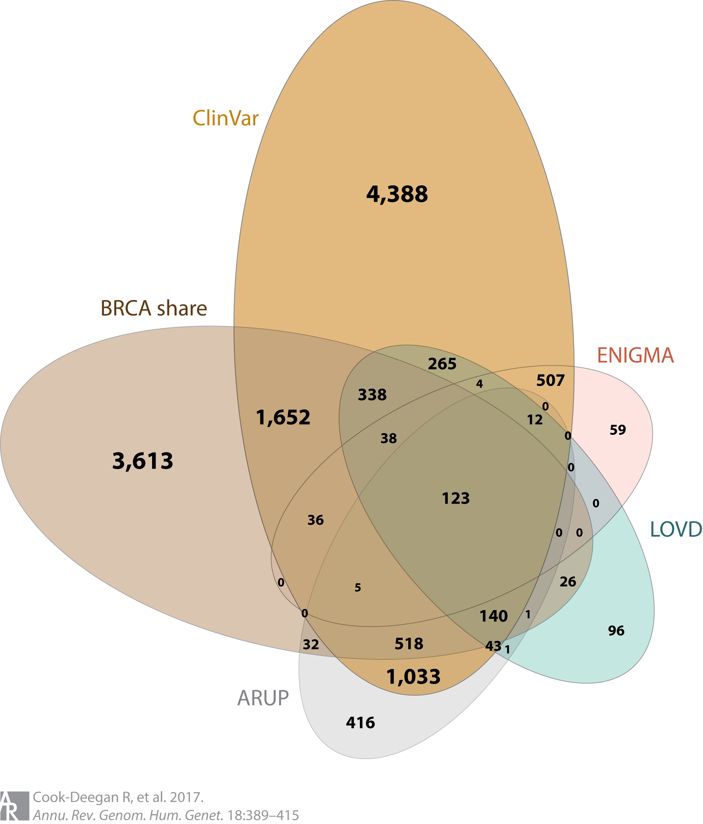
BRCA1/2 variants: Where to find them (2015)
BRCA Exchange reports 68,962 variants!
~12,000 “benign” or likely so
  ~12,000 high risk or likely so
  ~18,000 “unknown significance”
  ~25,000 “not reviewed”
Roughly as many still to be found
2016 report from China: 41% new mutations
  (not in public database)
Data mainly from commercial labs, not research labs

Slide 9
Policy domains
Make sharing data condition of payment
Patents
Inclusion & equity

Slide 10
Payer incentives
Medicare (and federal health programs): Congress
Centers for Medicare and Medicaid Services
Private payers

Slide 11
Can genes be patented?
Supreme Court decisions 2010-2015
Mayo (2012) and Myriad (2013)
Pushback
Coons-Tillis 2019 “Patent Restoration Act”
Pledged in Oct 2022 to act
Our role: history, analysis, synthesis

Slide 12
Inclusion of under-represented groups
Black and African American
Latino/Hispanic
Indigenous
Reasons for under-repsentation are access to care and participation in research (social factors)
Risk assessment is inherited DNA changes (biological factors)
Our role: publication, education, networking to groups

Slide 13
Work with experts
What’s the message?
Who needs to hear it?
What should they do about it?
Our role: collaboration with Burness Communications

Slide 14
Modified Heilmeier’s Catechism
What is the problem you’re trying to solve?
  Describe it with absolutely no jargon
Why is it important? (Why should I care?)
What options do you propose?
How is that different from what happens now?
What are the pros and cons of each option?
Who will support and who will oppose each option?
How will you know if it’s better than now?

